Slide 1

AI Applications in Archaeology
Laura Kriszgruber
Juillet 2024

Slide 2
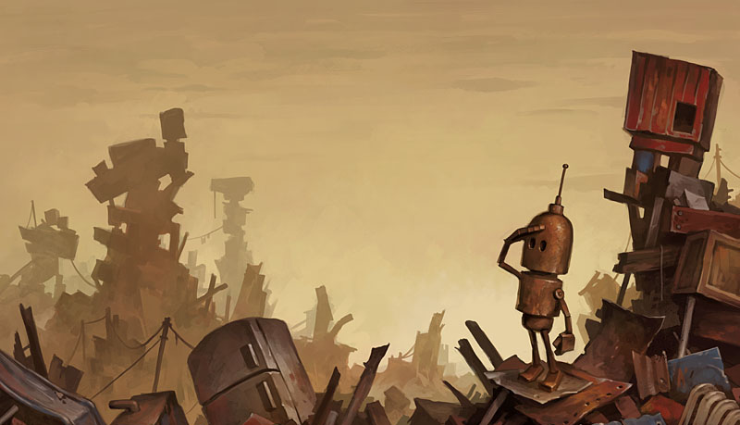
Agenda
Introduction
Applications
Herculaneum Scrolls
Challenges and considerations
Conclusion
Q&A
Sources
2

Slide 3
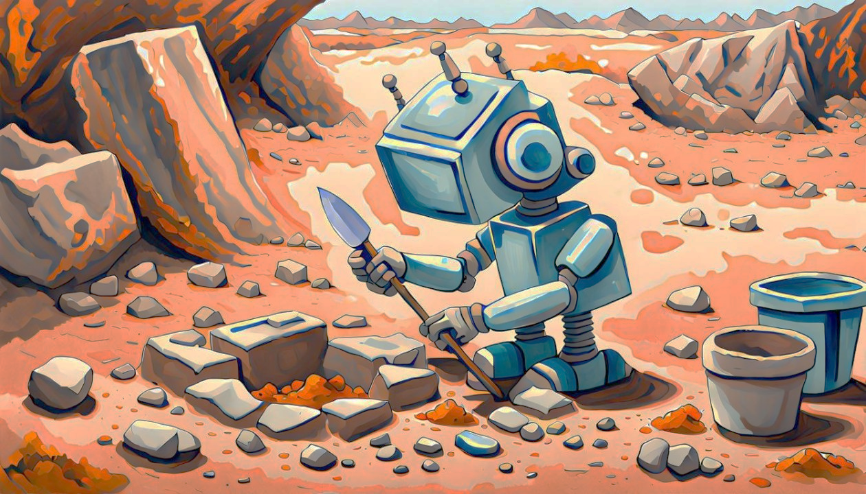
Introduction
What is archeology ?
“ The study of human history and prehistory through the excavation of sites and the analysis of artefacts and other physical remains. ”
- Oxford Languages
3
Notes:
whats is the time limit between archeoglogy and grave robbing ?
It's a question of legal permission. Time is not the significant factor. Grave robbing is when someone pilfers a grave, without a permit, for the purpose of personal gain. It doesn't matter whether that grave is ten years old or ten thousand years old.

Slide 4
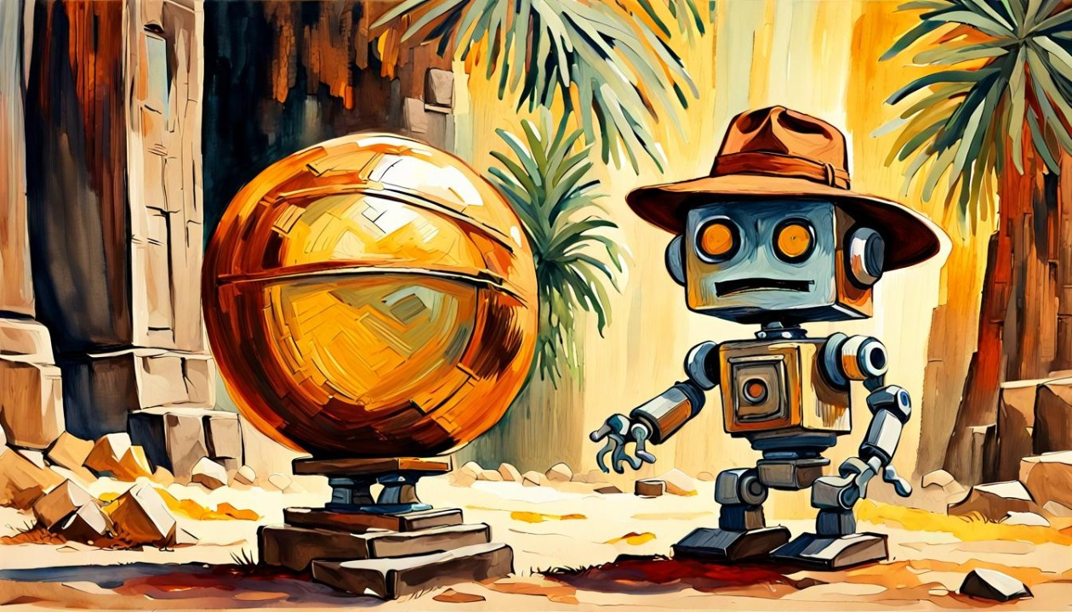
Applications
Automated Data Analysis
Site discovering
Artifact Analysis and Classification
Natural Language Processing
4

Slide 5

Automated data analysis
Old way
Data deluges
Decades of research deposited in archives
Consume vast amount of times
New way
AI navigate through extensive data efficiently
Streamlines archaeological research
AGNES project
5
Notes:
AI offers new insights and exciting opportunities to create knowledge from archaeological archives
The AGNES project facilitates large-scale synthesising research in the Netherlands, by integrating ML into a search engine which aims to index all the texts about archaeology in the region, some 200,000 documents. Named Entity Recognition to automatically detect all time periods, artefacts, and place names, which can then be used in search queries. This allows for more exhaustive and precise searches.
In a case study on early medieval cremations, researchers found that 30% more cremations were being found in the literature than were previously known

Slide 6
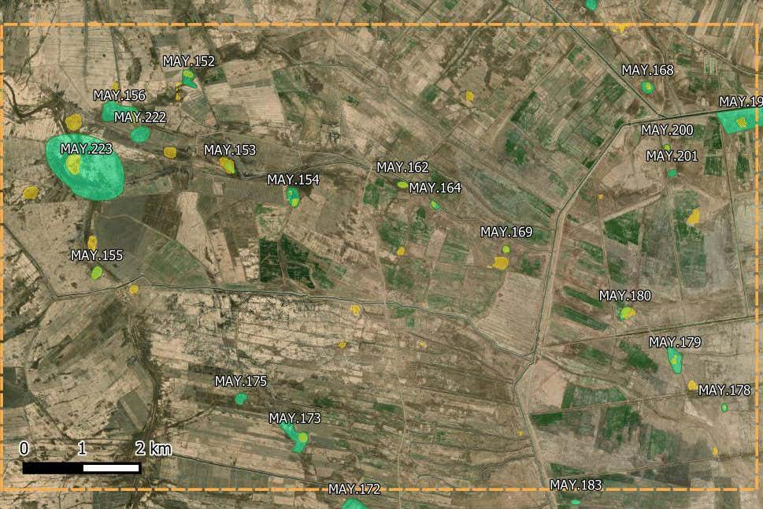
Site discovering
Maysan province, Iraq (Mesopotamian)
Old way
Dig and hope to find bones or walls (kinda)
The city of Troy and Homer’s Illiad
New way
Feeding data to a neural network :
Satellite Imagery and Remote Sensing
Changes in vegetation patterns or soils
Geographical Information Systems (GIS)
Layering of multiples data types
LIDAR Technology
Mayan Ruins in Guatemalan Jungle
6
AI predicted Potential site identified by archeologists
Notes:
Where exactly to dig ?
Neural network. Looking through millions of documents, archaeologists pass this documents and massive databases of geological information, not only direct archaeologists but also suggest territories that have similar patterns as potential objects for excavations.
Satellite : detect subtle anomalies on the earth’s surface. often indicate the presence of buried structures or artifacts. can signal human activity from centuries or millennia ago.
Light Detection and Ranging (LIDAR) technology, which uses laser pulses to create detailed 3D maps of the ground surface -> dense forest or overgrown
This targeted approach not only economizes time and resources but significantly heightens the likelihood of unearthing previously undiscovered archaeological treasures, fundamentally altering the dynamics of archaeological exploration.

Slide 7
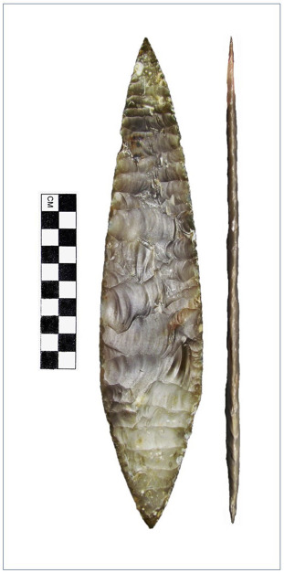
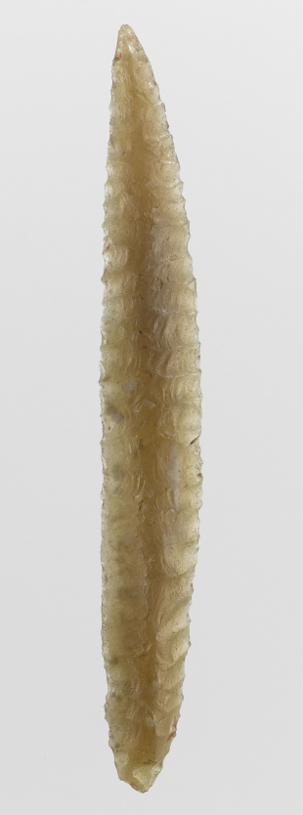
Artifact Analysis and Classification
Old way
“Maybe ritualistic ?”
New way
Image Recognition and Classification
Shapes, patterns, materials
3D Modeling and Reconstruction
Material Analysis
Spectroscopy and X-ray fluorescence
7
Notes:
AI can differentiate between pottery styles, tools, and decorative items, providing valuable information about the artifact’s origin and use.
These models help researchers understand the construction and function of artifacts without physical handling, which can be risky. In some cases, AI can even reconstruct fragmented artifacts, piecing together shards of pottery or broken statues to reveal their original form.
understand ancient manufacturing processes and trade networks
By examining data from techniques such as spectroscopy and X-ray fluorescence, AI can determine the materials used to create an artifac
Feuille de Laurier , Solutrean period, prehistoric, thin and long (some over 30cm), unusable for anything
Feuille de saule

Slide 8
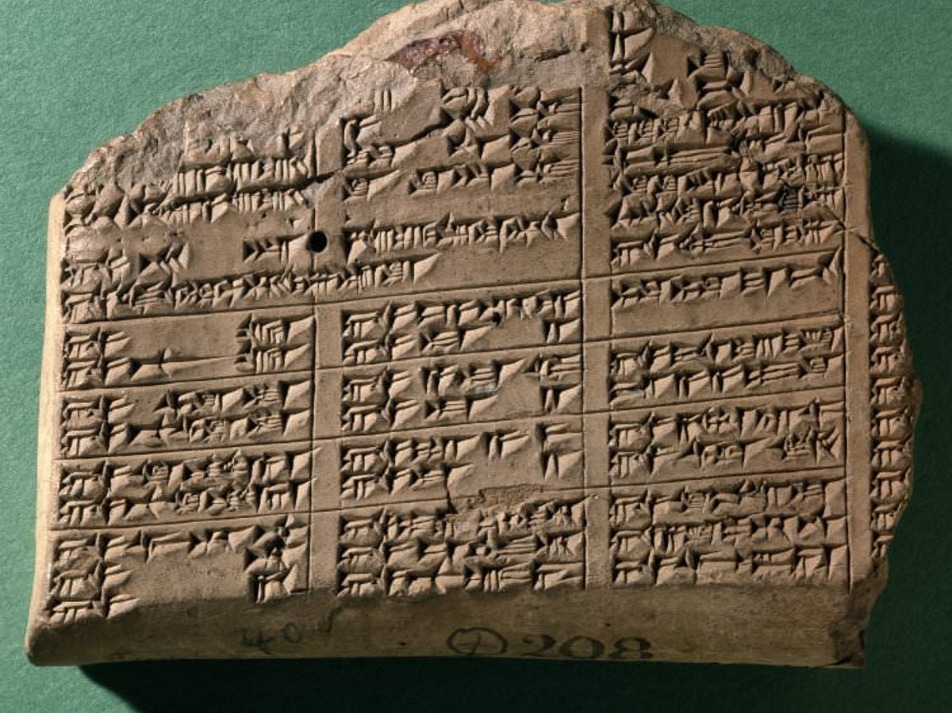
Natural Language Processing
Old way
Learn the language
New way
NLP and LLM
8
Notes:
Deciphering ancient inscriptions is a delicate task. NLP algorithms process linguistic nuances and context, helping archaeologists translate and interpret inscriptions more effectively. This accelerates the extraction of historical information from epigraphic sources.

Slide 9
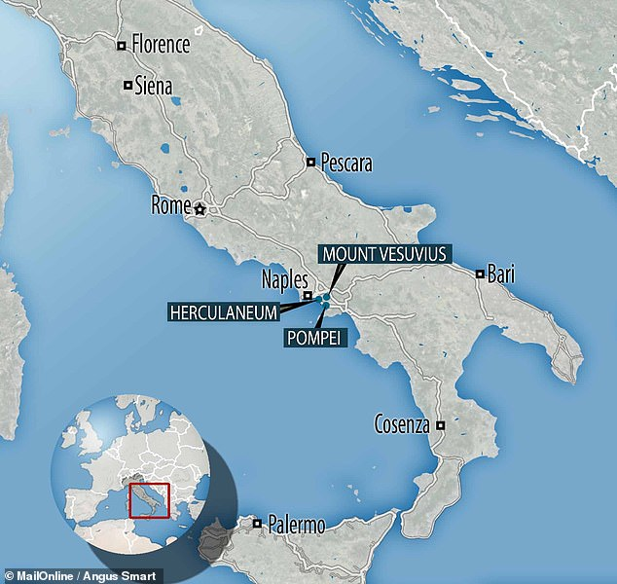
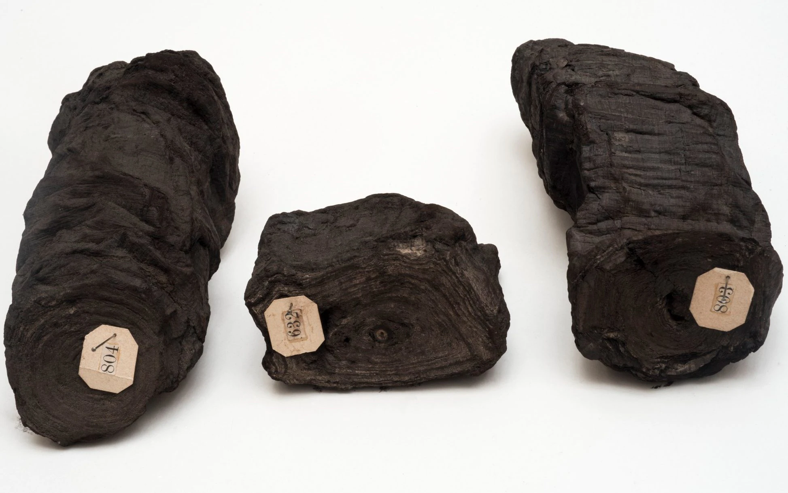
Herculaneum papyri
More than 1,800 scrolls in the Villa of the Papyri.
Only surviving library from antiquity existing in its entirety
Carbonized, unreadable
9
Notes:
The Herculaneum papyri are more than 1,800 papyrus scrolls discovered in the 18th century in the Villa of the Papyri in Herculaneum.
eruption of Mount Vesuvius in 79 AD.
The papyri, containing a number of Greek philosophical texts, come from the only surviving library from antiquity that exists in its entirety.^{[2]}
However, reading the scrolls is extremely difficult, and can risk destroying them.

Slide 10
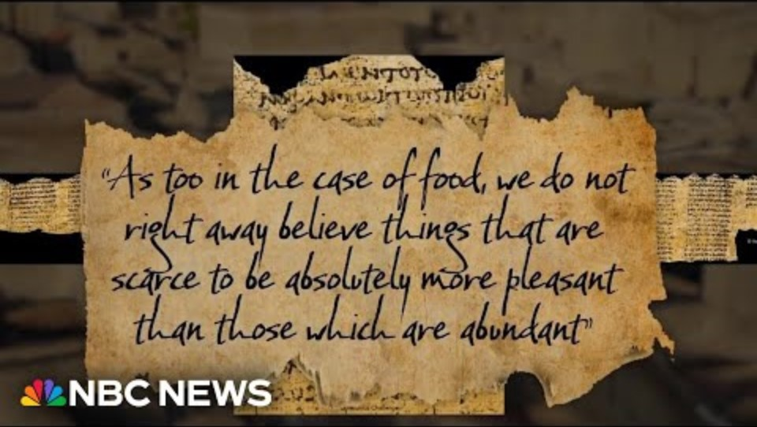
10
More info here
Notes:
Start at 0,5

Slide 11
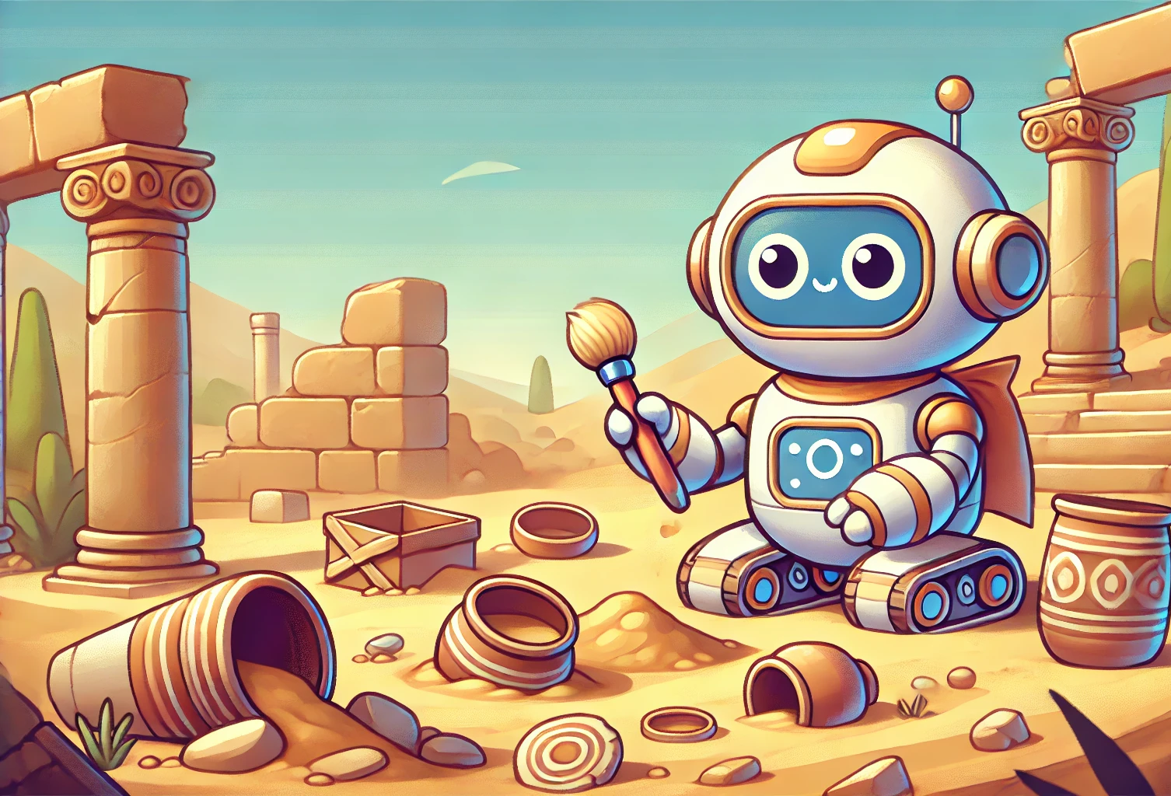
Challenges and considerations
Data quality, bias
Data security and privacy concerns
Ethical concerns
Interdisciplinary Consideration
11
Notes:
AI predictions : quality and completeness of the data
Striking a delicate balance between technological advancements and robust data protection measures is crucial in preserving the integrity of archaeological research and preventing unauthorized exploitation of historical knowledge.
Balanced with respect for cultural heritage and the interests of indigenous communities.
collaboration between archaeologists, data scientists, and AI experts

Slide 12
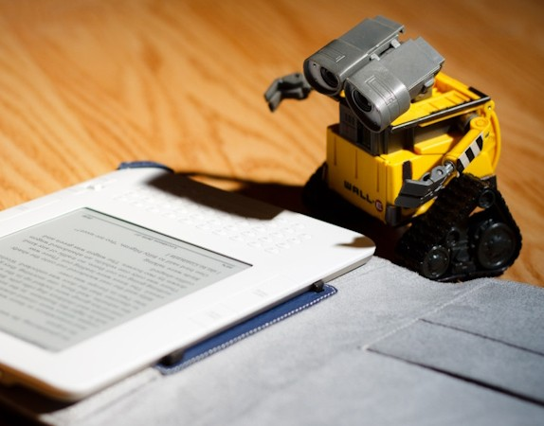
Conclusion
Paradigm shift
AI empowers archaeologists with unprecedented tools for discovery, analysis, and interpretation
Unprecedented speed and accuracy
The potential for AI in archaeology is limitless
12
Notes:
fundamental change in the underlying assumptions or methodology of a particular scientific discipline or other systematic practice.

Slide 13

Thank you for listening !
13

Slide 14
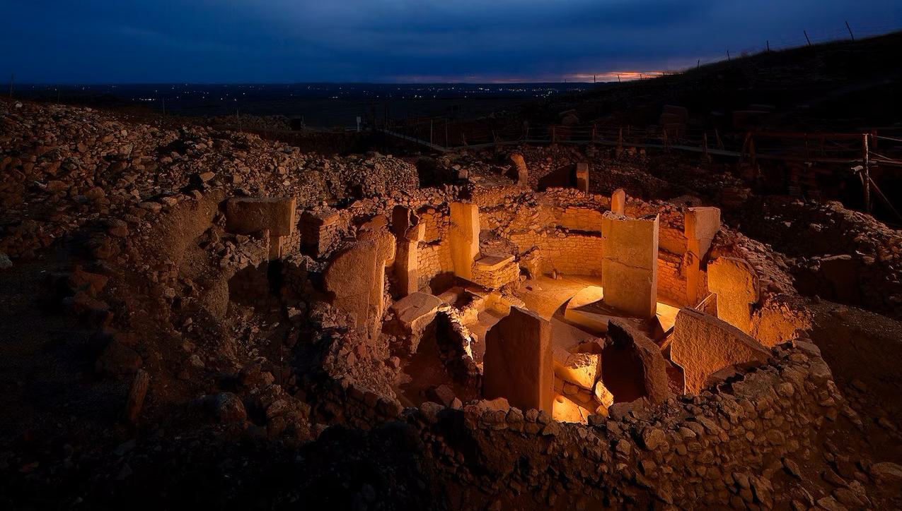
Q&A
14
Notes:
Gobekli Tepe, Near the border between Syria and turkey, considered the World’s Oldest Religious Site

Slide 15

Sources
https://www.linkedin.com/pulse/ai-archaeology-technologys-potential-helping-ai3dc/
https://intarch.ac.uk/journal/issue67/8/#:~:text=Within%20archaeology%2C%20AI%20can%20process,for%20contemporary%20and%20future%20research.
https://autogpt.net/the-role-of-ai-in-modern-archaeology/
https://www.nature.com/articles/s41598-023-36015-5
https://www.captechu.edu/blog/how-ai-and-technology-is-revolutionizing-archeology
https://medium.com/@futureaiweb/ai-in-archaeology-unlocking-mysteries-of-the-past-1774e2bae1cc#:~:text=The%20integration%20of%20AI%20with,to%20recreate%20intricate%20digital%20models.
https://intarch.ac.uk/journal/issue67/8/full-text.html#2
15
Notes:
https://www.nationalgeographic.com/travel/article/150120-gobekli-tepe-oldest-monument-turkey-archaeology
https://popular-archaeology.com/article/gobekli-tepe-discovering-the-worlds-oldest-religious-site/
https://www.linkedin.com/pulse/transformative-role-artificial-intelligence-science-archontia-barouda-qi76e/
https://www.britannica.com/topic/writing/Sumerian-writing
https://fr.wikipedia.org/wiki/Feuille_de_laurier_(outil_pal%C3%A9olithique)#:~:text=La%20feuille%20de%20laurier%20est,d'une%20feuille%20de%20laurier.
https://www.dw.com/en/heinrich-schliemann-the-man-who-discovered-troy/a-18946144#:~:text=But%20in%20all%20that%20time,northwest%20of%20present%2Dday%20Turkey.
https://www.cryptopolitan.com/ai-in-archaeology-mysteries-ancient-history/
https://intarch.ac.uk/journal/issue67/8/#:~:text=Within%20archaeology%2C%20AI%20can%20process,for%20contemporary%20and%20future%20research.
https://en.wikipedia.org/wiki/Herculaneum_papyri
https://intarch.ac.uk/journal/issue67/8/full-text.html
https://www.youtube.com/watch?v=AAa5zGM_rzg
https://www.youtube.com/watch?v=4CV2u4EPkIo
https://autogpt.net/the-role-of-ai-in-modern-archaeology/
https://www.linkedin.com/pulse/ai-archaeology-technologys-potential-helping-ai3dc/

